Slide 1
Study of the Stored
Grain Pests

Slide 2
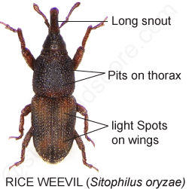
The adults are around 2 mm long with a long snout. The body color appears to be brown/black, but on close examination, four orange/red spots are arranged in a cross on the wing covers.

Slide 3
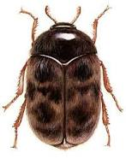
The biscuit beetle (Trogoderma granarium), also called cabinet beetle, is one of the world's most destructive pests of grain products and seeds. It is considered one of the 100 worst invasive species in the world. Infestations are difficult to control because of the insect's ability to survive without food for long periods, its preference for dry conditions and low-moisture food, and its resistance to many insecticides. Handling or consuming contaminated grain and seed products can lead to health issues such as skin irritation and gastrointestinal distress.

Slide 4
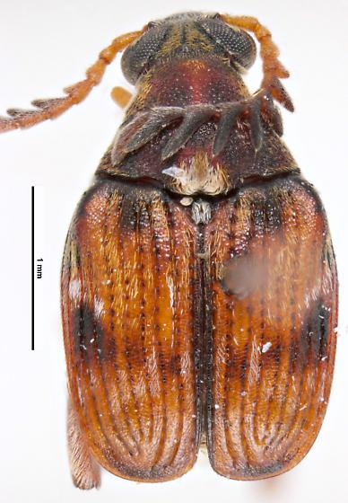
Callosobruchus chinensis is a common species of beetle found in the bean weevil subfamily, and is known to be a pest to many stored legumes. Although it is commonly known as the adzuki bean weevil it is in fact not a true weevil, belonging instead to the leaf beetle family, Chrysomelidae.

Slide 5
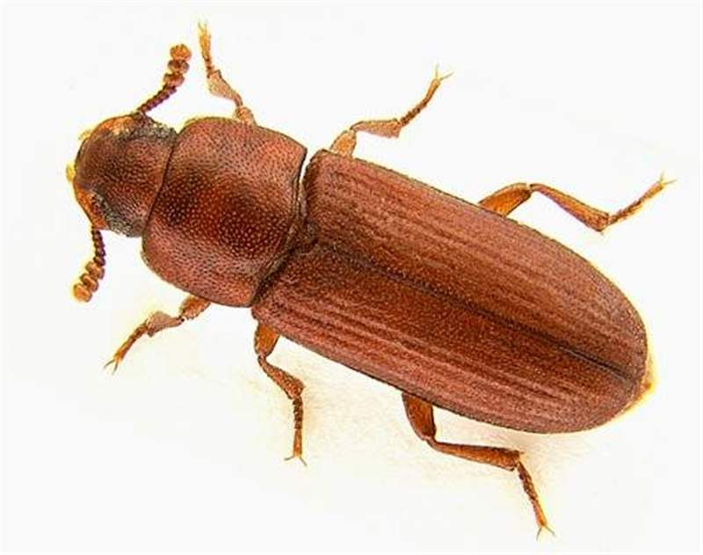
The red flour beetle (Tribolium castaneum) is a species of beetle in the family Tenebrionidae, the darkling beetles. It is a worldwide pest of stored products, particularly food grains, and a model organism for ethological and food safety research.

